Slide 1
SOFTWARE REQUIREMENTS SPECIFICATION | PHASE 1
Campaignly.AI
From a business description to a ready lead, in one guided workflow.
TEAM MEMBERS
SUPERVISOR
PROGRAMME
Majid Farooq Qureshi FA23-BCS-045
Habib Ur Rehman FA23-BCS-116
Ms. Saadia Maqbool
BS Computer Science (2023-2027)
COMSATS University Islamabad

Slide 2
SECTION 01
Problem Statement
1
The Problem
2
Impact
A Meta campaign needs an objective, audience, compliant copy, placement media, budget and monitoring.
Owners overspend on boosted posts, pay agencies or get ads rejected. Leads wait hours for a WhatsApp reply.
3
Target Users
4
Importance
Small and medium business owners in any industry, with no marketing training or agency.
SMBs depend on social ads, but disconnected tools hide whether campaigns deliver and leads get answered.
Core gap: no single, understandable workflow links campaign creation, policy awareness, lead capture and timely follow-up.
Campaignly.AI | SRS Presentation 2026-27
01

Slide 3
SECTION 02
Proposed Solution & Effectiveness
01
02
03
04
05
06
Onboard
Generate
Check
Deploy
Capture
Nurture
Reusable business profile
AI copy + media via RAG
Bradley Filter policy check
Owner confirms, Meta API
Leads synced and encrypted
AI WhatsApp + takeover
Expected benefits
No expertise needed
Fewer rejections
Faster lead response
One protected workspace
4 of 5 first-time users reach a reviewable ad within 15 minutes.
Policy risks flagged before submission; Meta still decides.
AI replies within 60 s; owner alerted at intent score 70.
Tenant-isolated data under one AUD Stripe subscription.
NFR-USE-001
FR-015
NFR-PER-006
FR-080
Campaignly.AI | SRS Presentation 2026-27
02

Slide 4
SECTION 03
Scope Evaluation Feedback & Improvements
Evaluation | Committee feedback | Action taken
FYP-0 Spring 2026 | Accepted with minor revisions. Expand beyond campaign generation to a complete AI workflow. | End-to-end flow: generate, evaluate, learn, recommend, deploy, observe, optimise.
FYP-0 Spring 2026 | Incorporate human oversight throughout the AI pipeline. | Owner review and approval checkpoints before deployment and optimisation.
FYP-1 Fall 2026 | Strong idea. Define AI evaluation, personalisation and optimisation beyond basic API calls. | Measurable checks, history-based recommendations and performance-driven tuning.
Resulting changes in the SRS
FR-011
Readability + policy scores
FR-014
RAG on versioned dataset
FR-028
Owner confirms every deploy
FR-016
Advisory recommendations
FR-085
Intent score, ready at 70
FR-052
Manual WhatsApp takeover
Campaignly.AI | SRS Presentation 2026-27
03

Slide 5
SECTION 04
Key Modules & Features
01
Business Onboarding & Brand
02
AI Ad & Content Generation
BO-1
BO-2 BO-8
Wizard, tone, industry, resume, AI tips
Copy variations, templates, RAG, policy check
03
AI Media Editing & Creative
04
Meta Campaign Automation
BO-2
BO-3 BO-6
Upload, resize, brand, captions, snippets
OAuth, 6 objectives, targeting, sync, control
05
Lead Management
06
AI WhatsApp Lead Nurturing
BO-4 BO-6
BO-9
Lead-form sync, encryption, filters, analytics
Replies, follow-ups, intent score, takeover
07
Subscription & Billing
08
Admin Dashboard & Operations
BO-5
BO-7 BO-8
Stripe Checkout, 14-day trial, AUD plans
Users, AI usage, Meta health, jobs, dataset
09
Marketing Website
10
Authentication & Users
Acquisition
BO-4 BO-6
Landing, pricing, diagnostic, enquiries, blog
Email, Google, sessions, roles, tenancy
10 modules | 78 scope features + 11 baseline additions = FR-001 to FR-089 | Tags show the business objective served
Campaignly.AI | SRS Presentation 2026-27
04

Slide 6
SECTION 05
System Actors
Business User
Administrator
Public Visitor
WhatsApp Prospect
Owner of an SMB in any industry. Creates ads, runs campaigns and answers leads. Sees only own business data.
Operates the platform: users, AI usage, Meta health, jobs, referrals and dataset. No lead PII.
Browses the website, pricing and free diagnostic, enquires or registers. No dashboard access.
Lead from a Meta form or the business number. Chats on WhatsApp only and can opt out anytime.
EXTERNAL SYSTEM ACTORS
Meta Platform
WhatsApp Cloud API
Stripe
Google Identity
AI Service (Gemini / Groq)
Geocoding
Email Service
Job Scheduler
Non-human actors: authenticated API calls and verified webhooks.
Campaignly.AI | SRS Presentation 2026-27
05

Slide 7
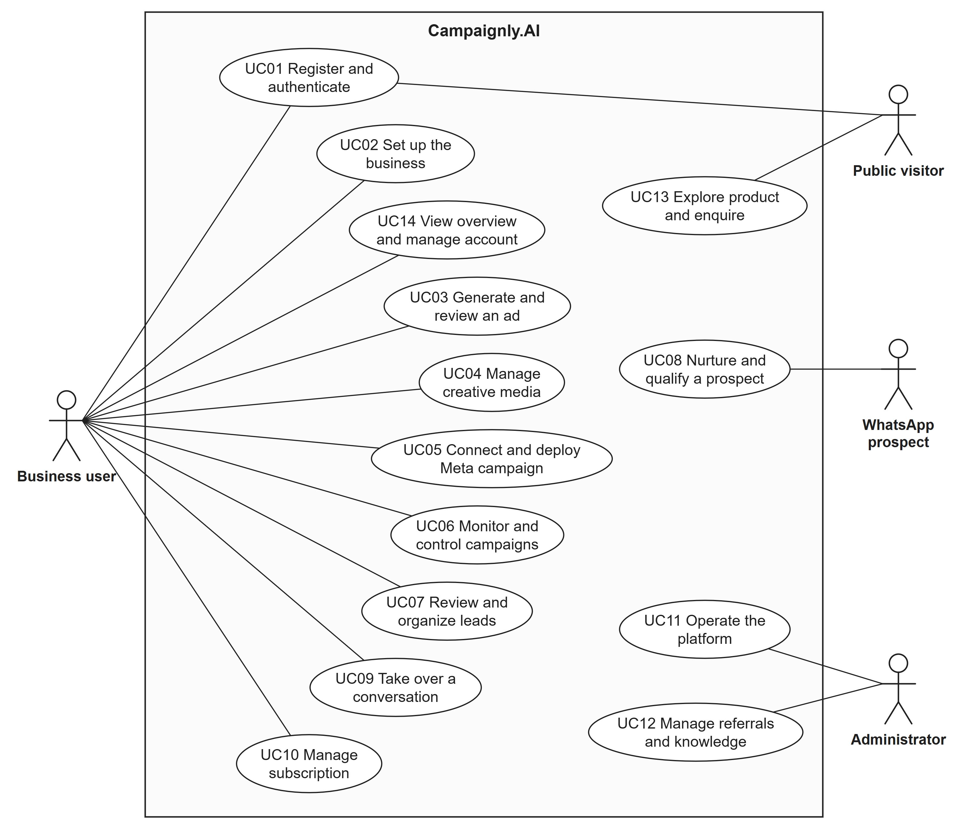
SECTION 05
Use Case Diagram: System Level
14 use cases | 4 human actors
Business user
11 use cases: set up, generate, media, deploy, monitor, leads, takeover, billing
Public visitor
UC01 register, UC13 explore and enquire
WhatsApp prospect
UC08 nurture and qualify a prospect
Administrator
UC11 operate platform, UC12 referrals and knowledge
External systems appear in the detailed diagrams (SRS Fig. 2.2-2.7).
Campaignly.AI | SRS Presentation 2026-27
06

Slide 8
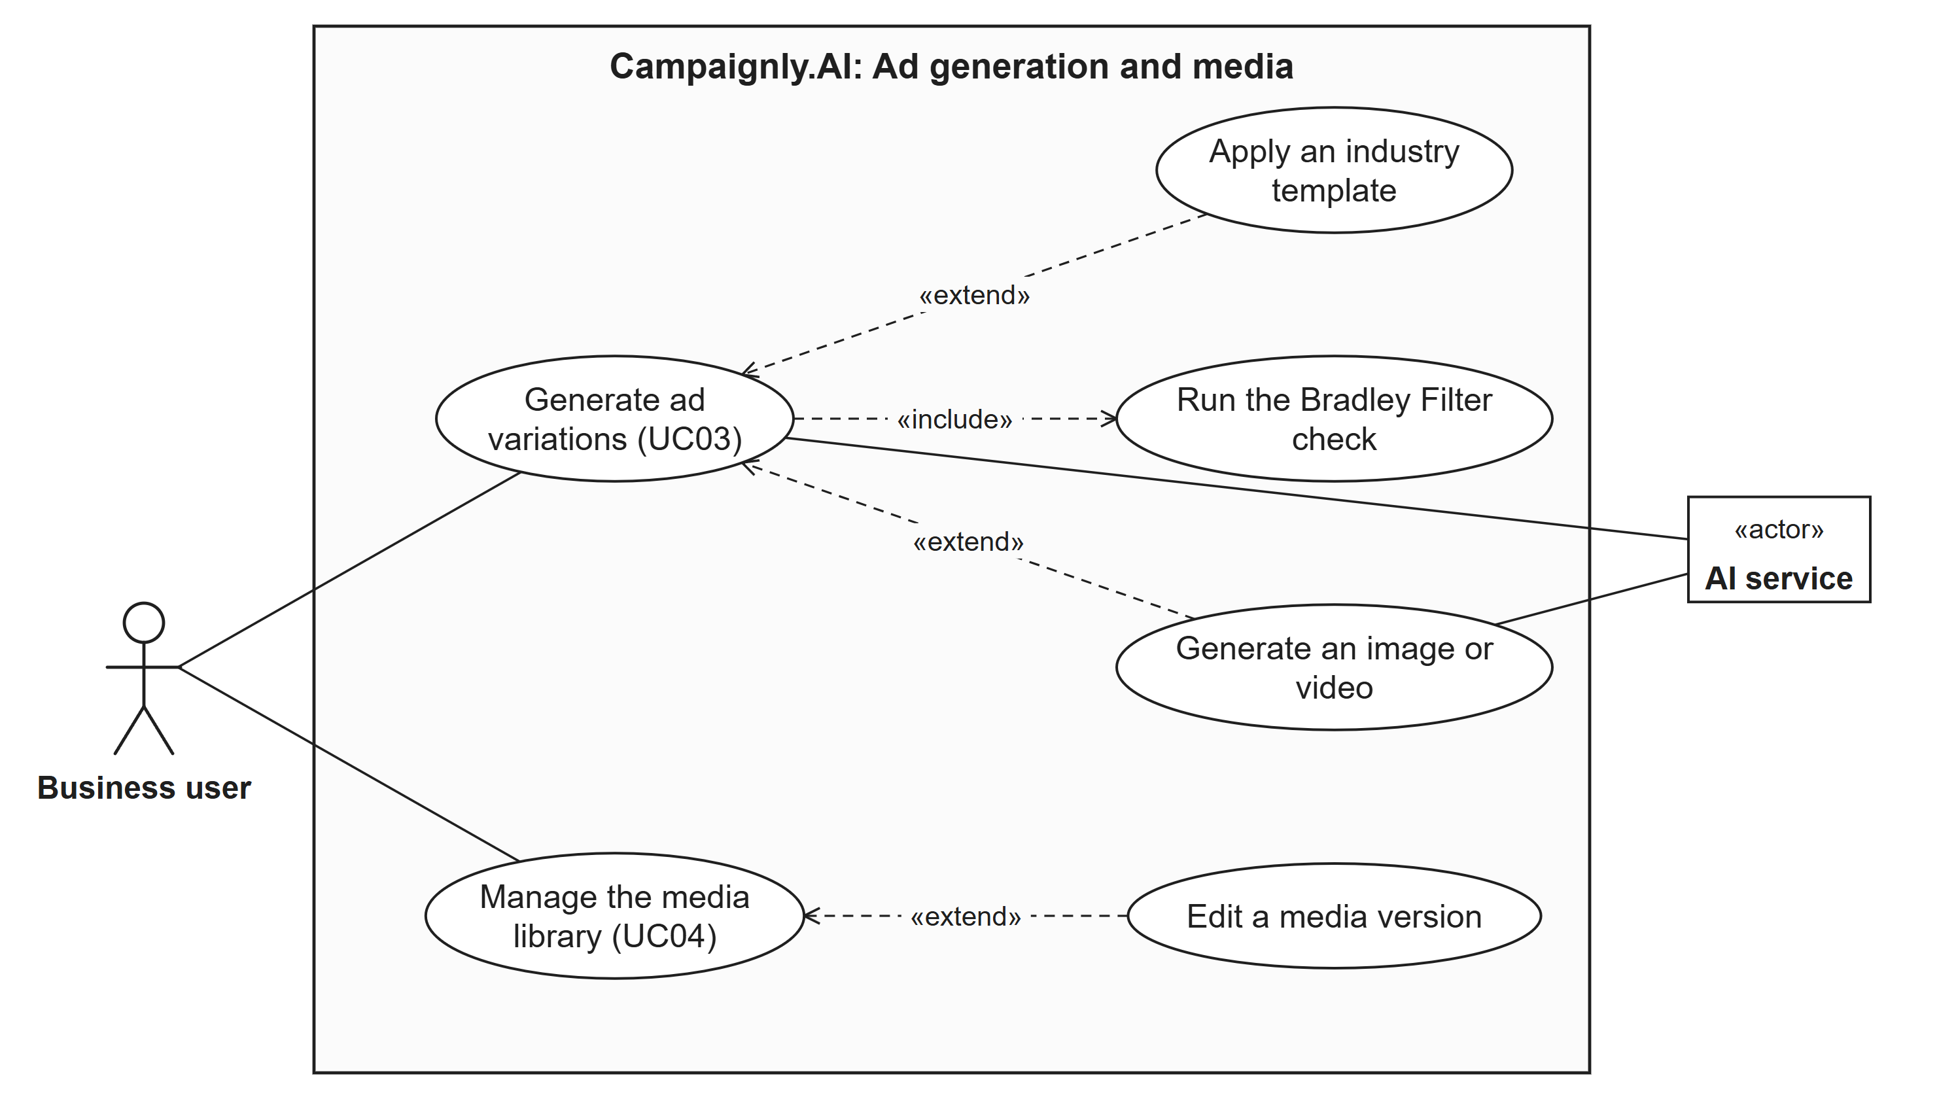
SECTION 05
Use Case Relationships: include & extend
«include» always performed
Generate ad runs the Bradley Filter
Deploy rechecks filter + location
Onboarding resolves the location
Nurturing always scores intent
«extend» only on a condition
Google sign-in or forgot password
Owner asks for onboarding tips
Owner picks an industry template
Plan allows image or video
Owner edits a media asset
Lead score first reaches 70
Detailed view: ad generation and creative media (UC03, UC04)
Campaignly.AI | SRS Presentation 2026-27
07

Slide 9
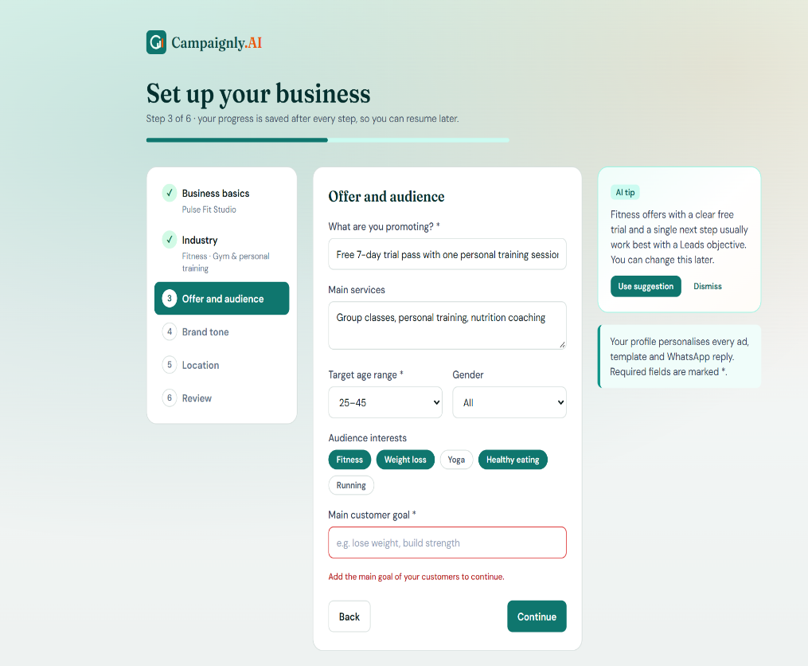
SECTION 06 | MOCKUPS, FRS, RULES & EVENTS
Workflow 1: Business Onboarding
Functional requirements
FR-001
Guided steps with validation and progress
FR-005
Resume the latest incomplete step
FR-087
Name, industry, offer, audience, tone, location required
Business rules
BR-003
Location must be resolved
BR-012
Profile grounds generation
M01-S01 Business Onboarding Wizard
Event / trigger | System response | Exception handling
Owner submits a step | Validate, save step, geocode location | Invalid step keeps entries, shows errors
Campaignly.AI | SRS Presentation 2026-27
08

Slide 10
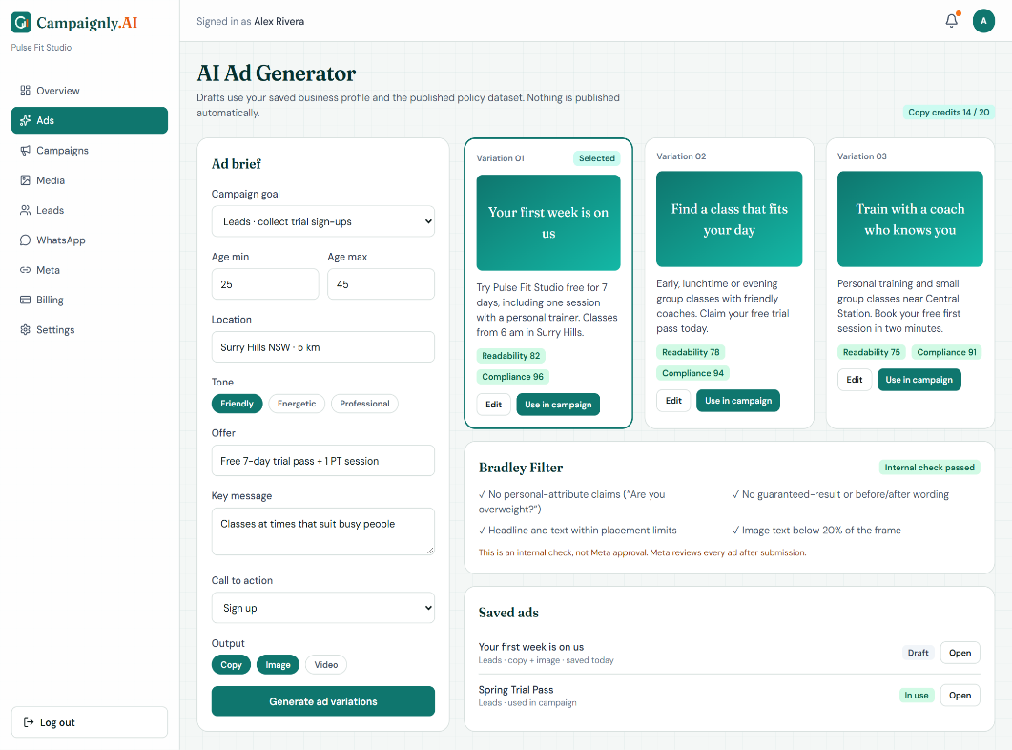
SECTION 06 | MOCKUPS, FRS, RULES & EVENTS
Workflow 2: AI Ad Generation
Functional requirements
FR-008
Editable draft from brief + profile
FR-011
Readability and compliance scores
FR-012
Variations bounded by credits
Business rules
BR-002
Filter is not Meta approval
BR-006
Plan limits control credits
M02-S01 AI Ad Generator
Event / trigger | System response | Exception handling
EV-01 Generation requested | Reserve credit, retrieve RAG context, call AI, check, save | Timeout releases credit; never publishes
Campaignly.AI | SRS Presentation 2026-27
09

Slide 11
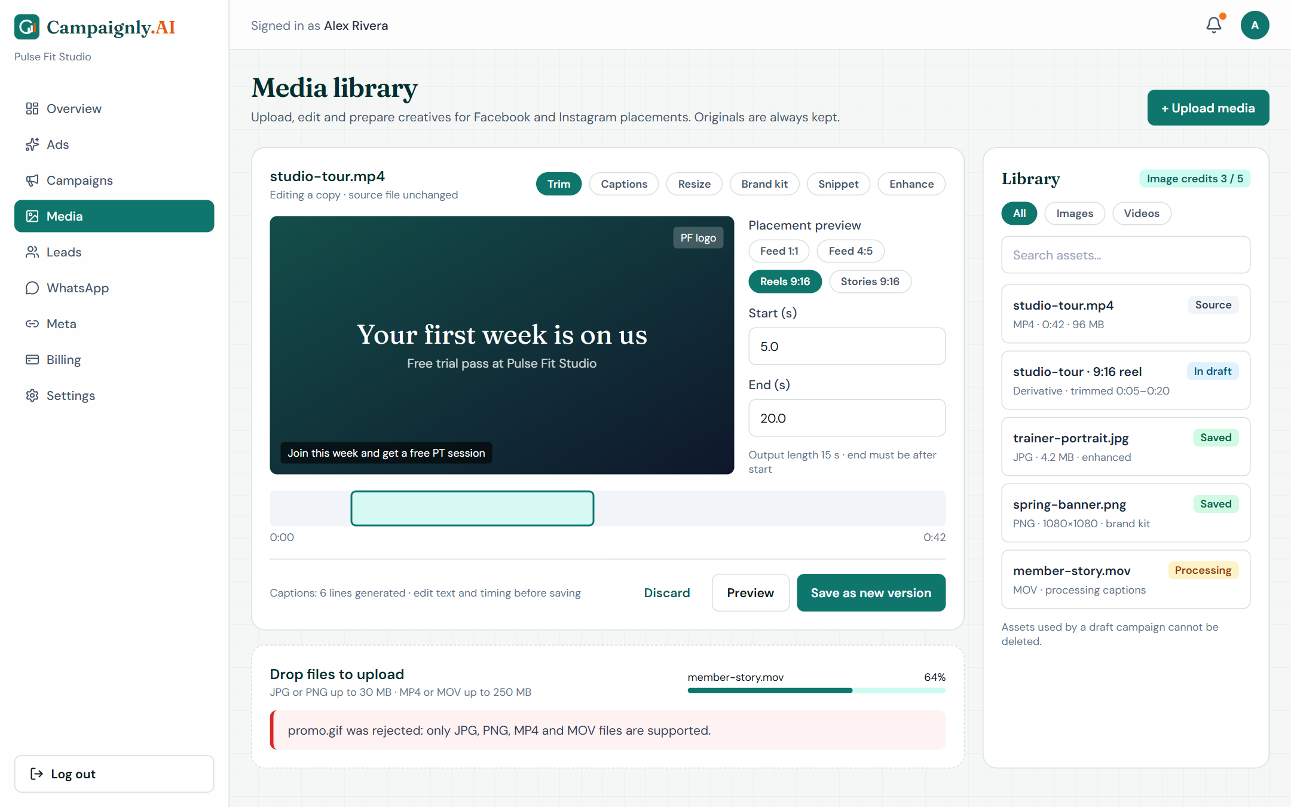
SECTION 06 | MOCKUPS, FRS, RULES & EVENTS
Workflow 3: Media Studio
Functional requirements
FR-017
JPG/PNG 30 MB, MP4/MOV 250 MB validated
FR-019
Editable captions with timing preview
FR-020
Resize per Meta placement, source kept
Business rules
BR-010
Every file has one tenant
BR-001
Facebook + Instagram sizes
M03-S01 Media Studio and Editor
Event / trigger | System response | Exception handling
EV-02 Upload or edit done | Verify type and signature, store privately, new version | Invalid file rejected; failure keeps source
Campaignly.AI | SRS Presentation 2026-27
10

Slide 12
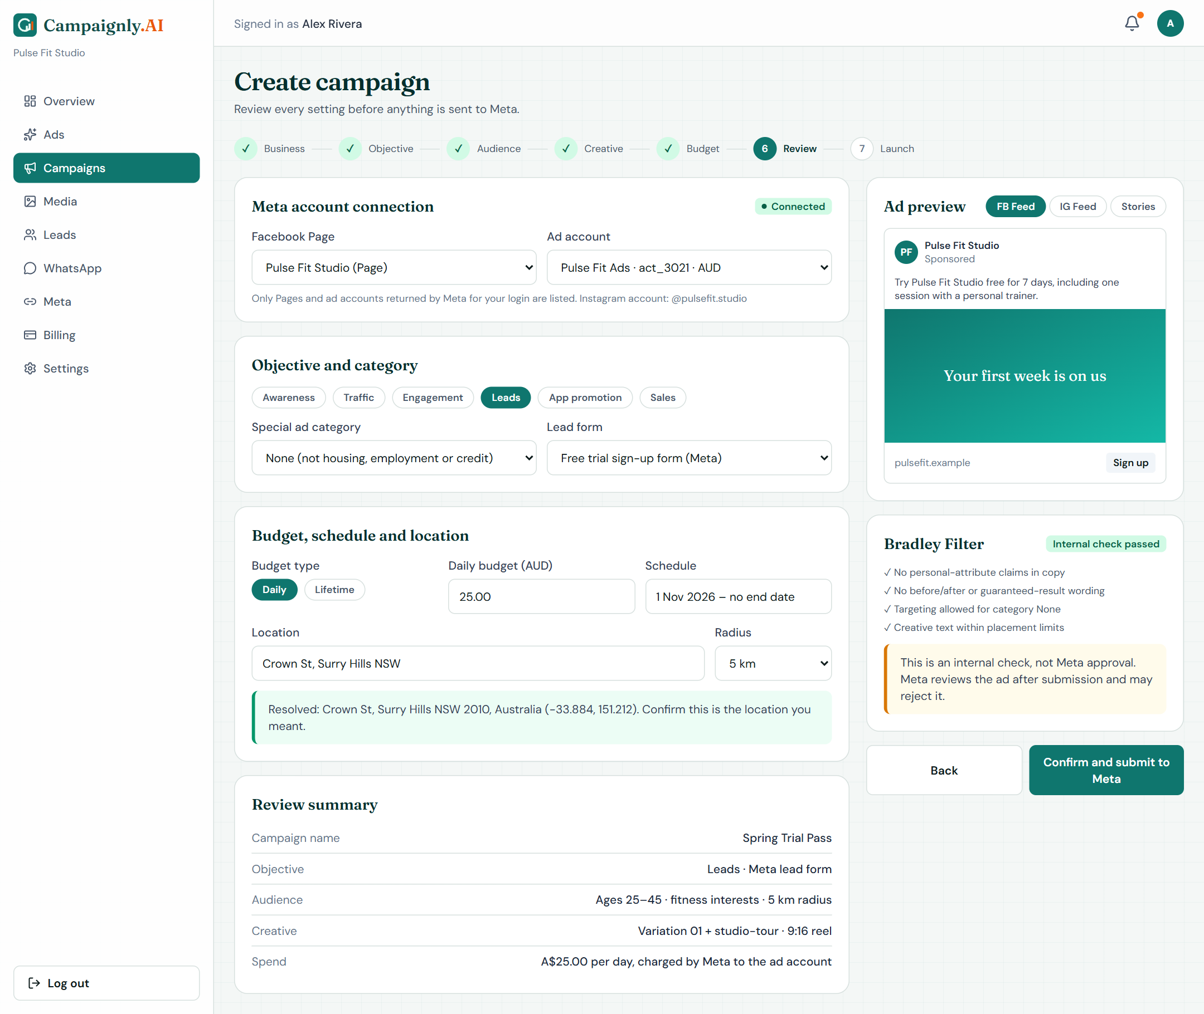
SECTION 06 | MOCKUPS, FRS, RULES & EVENTS
Workflow 4: Meta Campaign Deployment
Functional requirements
FR-026
Meta OAuth with validated state
FR-028
6 objectives, budget, schedule, review
FR-030
Geocoded location confirmed by owner
Business rules
BR-005
Bad token blocks Meta writes
BR-009
Owner action publishes
M04-S01 Meta Connection and Campaign Review
Event / trigger | System response | Exception handling
EV-04 Campaign submit | Recheck entitlement and token, create Meta objects, store IDs | Keep last state; reconcile before retry
Campaignly.AI | SRS Presentation 2026-27
11

Slide 13
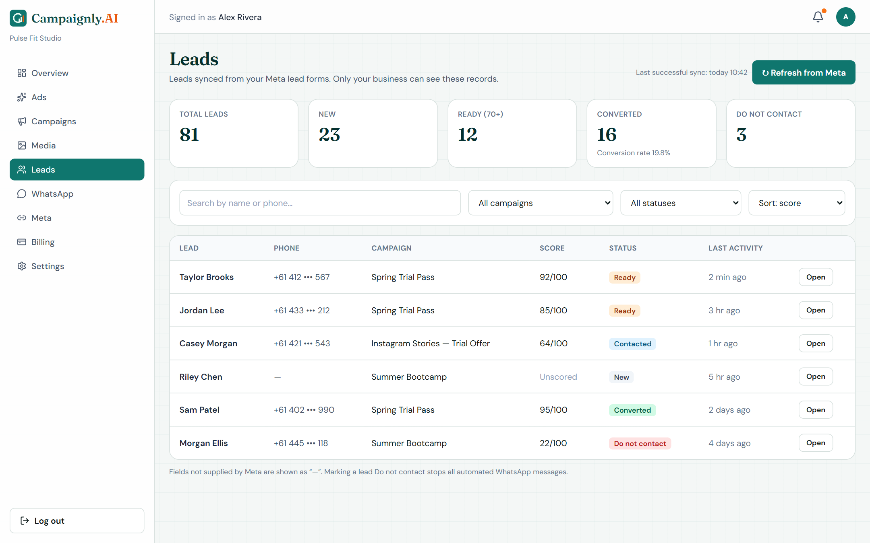
SECTION 06 | MOCKUPS, FRS, RULES & EVENTS
Workflow 5: Lead Management
Functional requirements
FR-037
Upsert leads by tenant + Meta lead ID
FR-038
Manual refresh with last sync time
FR-041
Search, filter, status incl. Do not contact
Business rules
BR-008
Leads visible to owner only
BR-011
DNC stops automation
M05-S01 Leads Workspace
Event / trigger | System response | Exception handling
EV-06 Lead sync or Refresh | Fetch pages, upsert, encrypt PII, keep owner notes | Partial failure keeps cursor and records
Campaignly.AI | SRS Presentation 2026-27
12

Slide 14
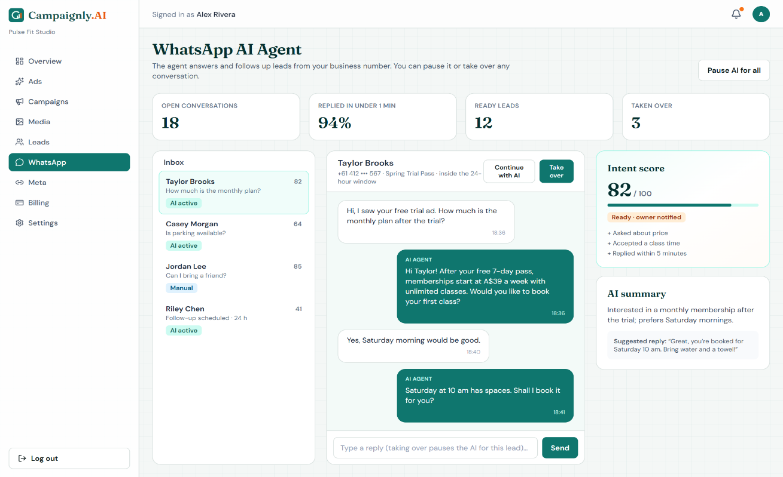
SECTION 06 | MOCKUPS, FRS, RULES & EVENTS
Workflow 6: AI WhatsApp Nurturing
Functional requirements
FR-044
Send only with opt-in and entitlement
FR-046
Intent score 0-100 with reason
FR-052
Owner takeover pauses the AI
Business rules
BR-011
Takeover / STOP halts replies
BR-008
Transcripts stay private
M06-S01 WhatsApp AI Agent and Takeover
Event / trigger | System response | Exception handling
EV-08 Nurturing job due | Recheck opt-in, use template outside 24 h, send, store ID | Retry after 1, 5, 15 min; hold if no template
Campaignly.AI | SRS Presentation 2026-27
13

Slide 15
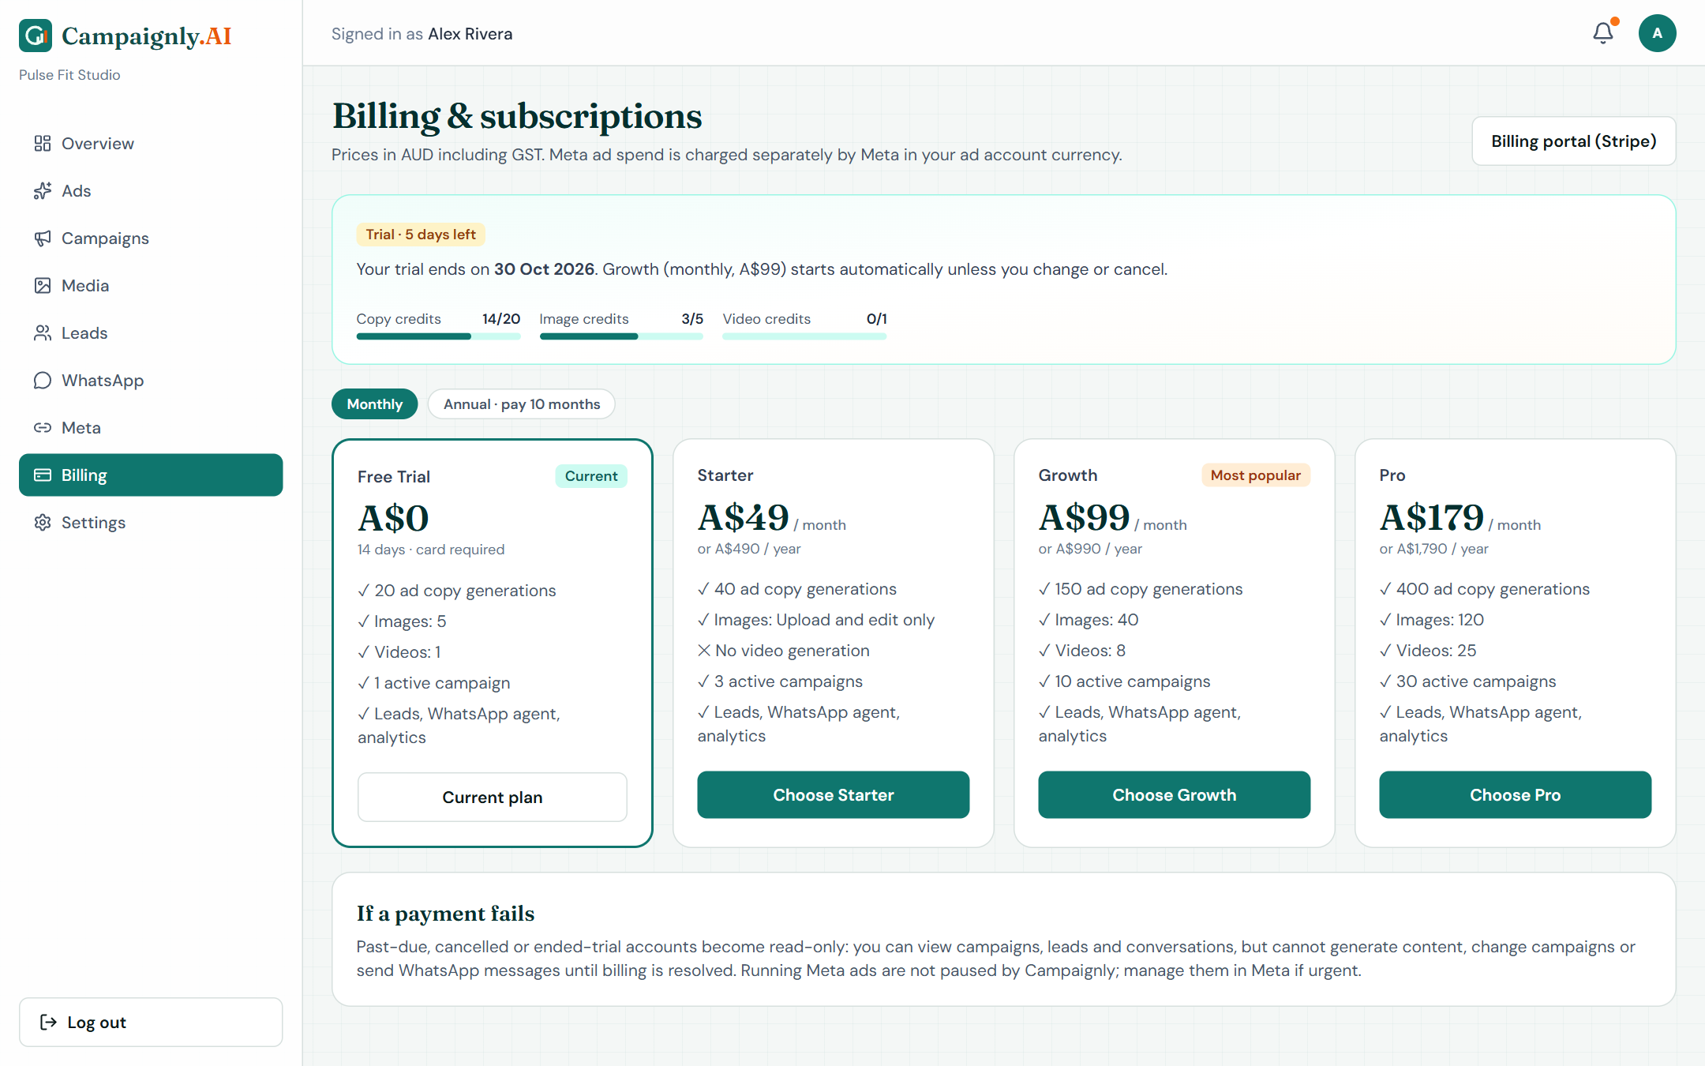
SECTION 06 | MOCKUPS, FRS, RULES & EVENTS
Workflow 7: Subscription & Billing
Functional requirements
FR-053
Stripe Checkout from server-side price
FR-054
14-day card-backed free trial
FR-057
Access matrix enforced on API + jobs
Business rules
BR-006
Status controls actions
BR-007
AUD incl. GST pricing
M07-S01 Billing and Subscription
Event / trigger | System response | Exception handling
EV-12 Stripe webhook | Verify signature, dedupe, fetch subscription, update credits | Invalid signature changes nothing
Campaignly.AI | SRS Presentation 2026-27
14

Slide 16
SECTION 07
Non-Functional Requirements
Performance
NFR-PER
Security
NFR-SEC
95% of pages usable within 4 s
95% of API reads under 500 ms
Ad draft or failure within 30 s
Webhooks acknowledged in 2 s
Lead PII encrypted at rest
HTTPS with TLS 1.2+ everywhere
Zero cross-tenant access
Signed webhooks; no leaked secrets
Usability
NFR-USE
Reliability
NFR-REL
4 of 5 novices draft an ad in 15 min
WCAG 2.2 AA, 4.5:1 text contrast
Pending state shown within 1 s
Errors name the field, keep input
99.5% monthly availability
MTBF of at least 720 hours
Replays create zero duplicates
Last good data kept on failure
Campaignly.AI | SRS Presentation 2026-27
15

Slide 17
SECTION 07
External Interfaces & Constraints
User Interfaces
Software Interfaces
Campaignly design system, sidebar navigation, labelled status badges, confirmations on risky actions, keyboard support.
Meta Marketing API + Lead Ads, WhatsApp Cloud API, Stripe, Google OIDC, Gemini and Groq, geocoder, email, AWS S3.
Hardware Interfaces
Communications
No direct hardware. Any computer, tablet or phone with a modern browser; hosting sized to the performance targets.
HTTPS + JSON, email and in-app alerts, WhatsApp via the business number only, verify-then-acknowledge webhooks.
CONSTRAINTS & OPERATING ENVIRONMENT
Next.js, logic on server only
Prisma: SQLite, then PostgreSQL
Meta APIs after app review
Stripe only; no card storage
4 major browsers, 360-1920 px
Secrets only in server config
Campaignly.AI | SRS Presentation 2026-27
16

Slide 18
Thank You
Questions & Discussion
Majid Farooq Qureshi (FA23-BCS-045) | Habib Ur Rehman (FA23-BCS-116)
Supervisor: Ms. Saadia Maqbool | COMSATS University Islamabad

